Slide 1
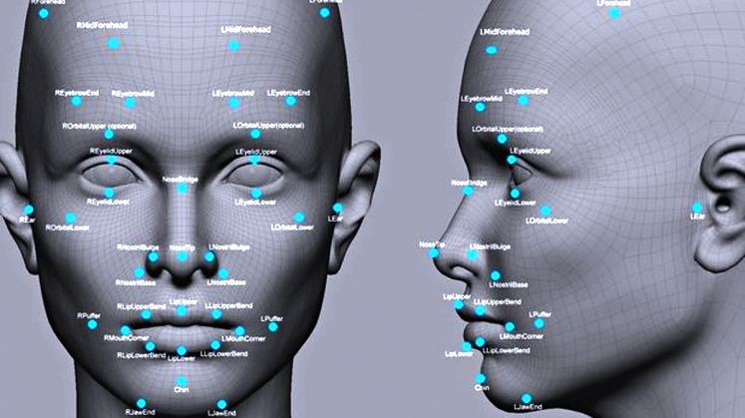
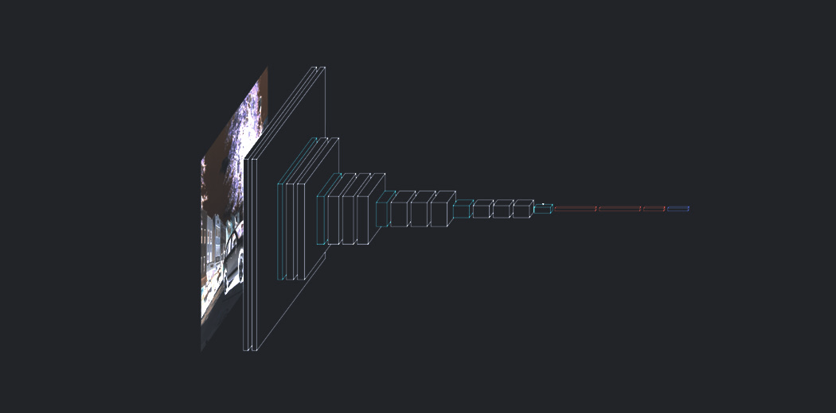
Image and Emotion Detection and Caption Generator
By:
Abhishek Kumar
Ananya
Kashish Agrawal
Pratyush Ojha
Shivshankar
Dhruv
Mentor:

Slide 2
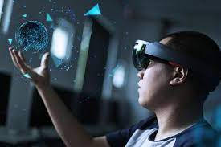

Overview:
The Model consists of two architectures :
Emotion Detector
Caption Generator
Applications:
Emotion Detection:
In the long run can be used in video gaming to detect emotions via facial expressions and adapt in the game.
Medical diagnosis to treat diseases like depression and dementia.
Fraud detection
In various Recruitment procedures
Caption Generator:
Assistance for visually impaired.
Recommendations in Editing applications.
Social media posts

Slide 3
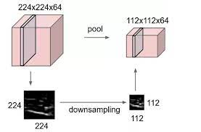
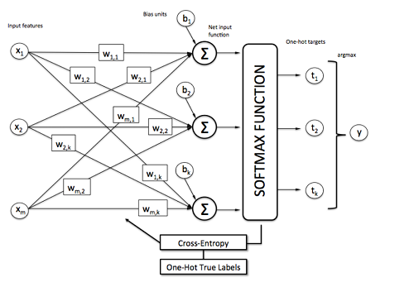
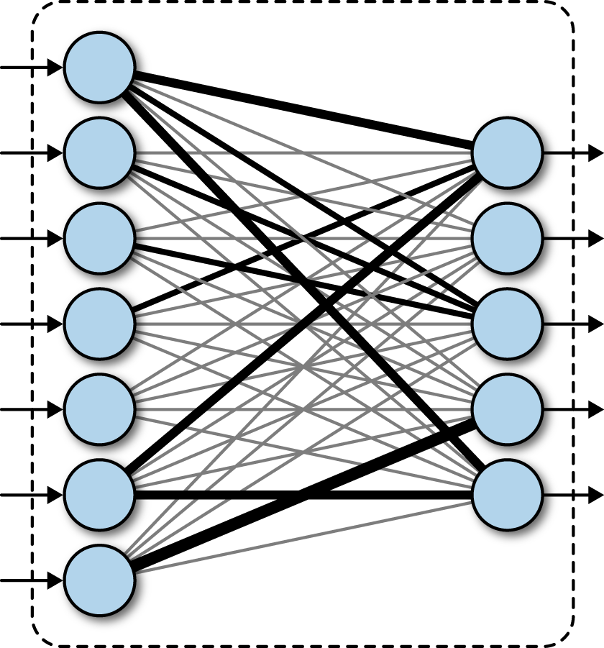
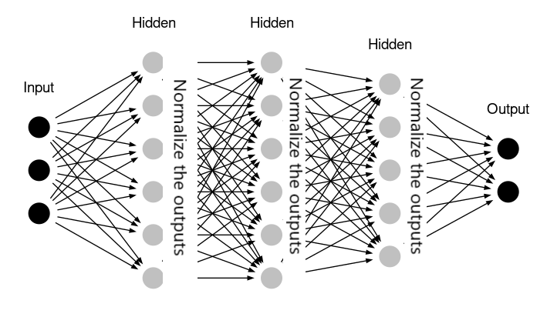
Emotion detector
We have used fer2013 dataset to train our emotion detection model.
The model CNN architecture consists of the following types of layers:
CONV2D layer
Maxpooling layers
Batch normalization layer
Topmost fully connected layers
Softmax layer for classification

Slide 4
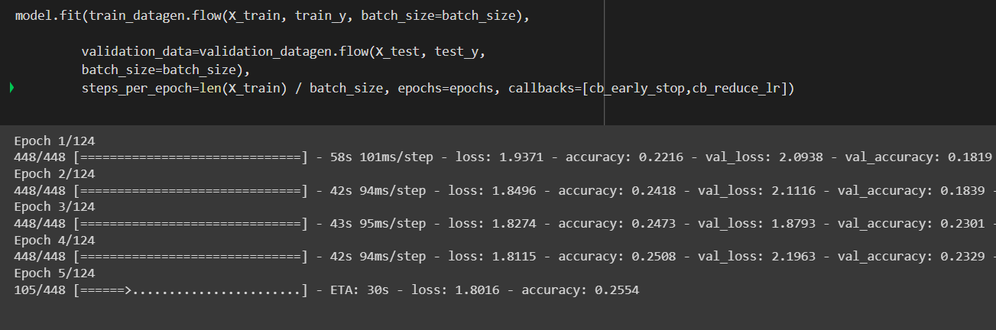
Working of emotion detector model
The model is trained by passing the fer2013 dataset image through the CNN architecture explained before.
The conv layers find patterns and maintain locality by finding relations and patterns between the neighbour pixels.
The maxpooling layers provide translational invariance.
Batch normalization layers help in faster convergence.
We have used data augmentation and early stopping to reduce overfitting.
The conv layers are flattend into a fully connected network with a softmax activation at the last layer to predict the emotion.
The best of 5 accuracy achieved was approx. 60%, whereas the human level accuracy on the dataset is approx. 65%.

Slide 5
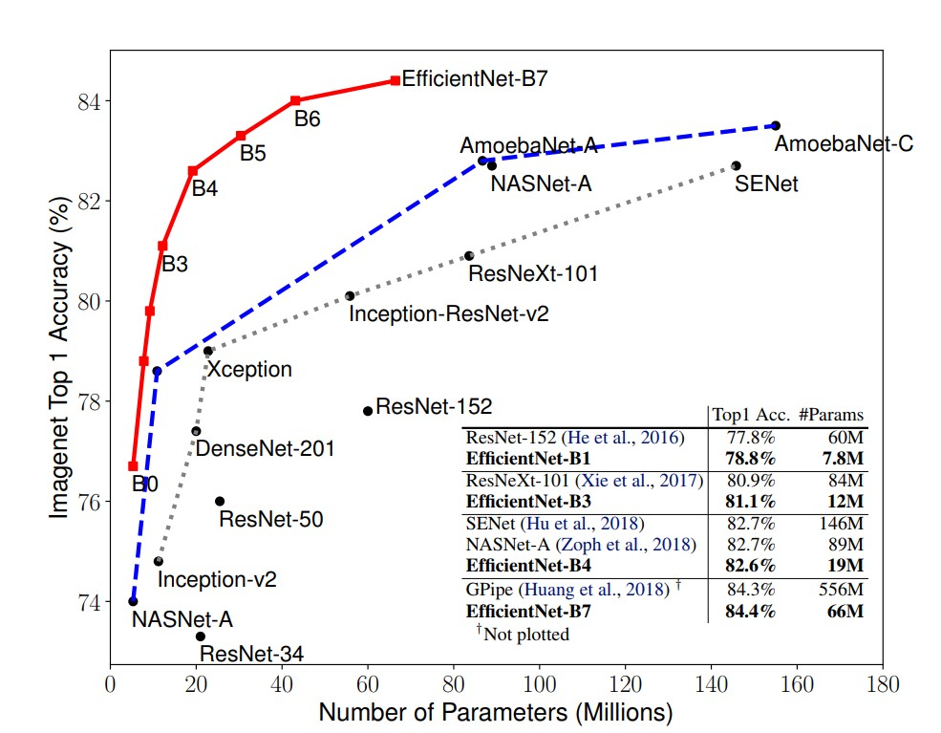
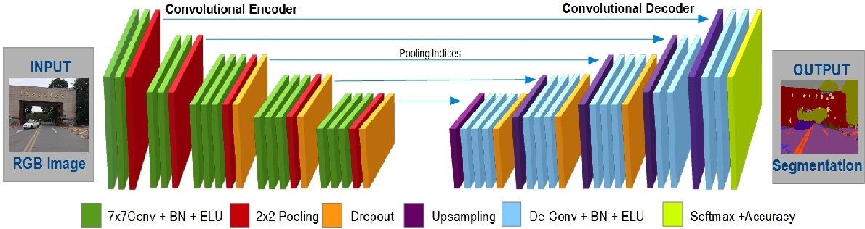
Caption generator
We have trained our caption generator on the flickr8k dataset because it contains a large number of images focusing on people and their actions. The model architectures consists of the following:
A CNN architecture using transfer learning on Efficientnet
A transformer encoder block
A transformer decoder block

Slide 6
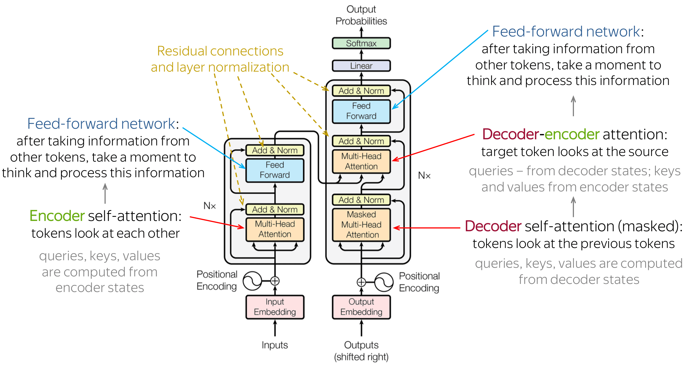

Slide 7
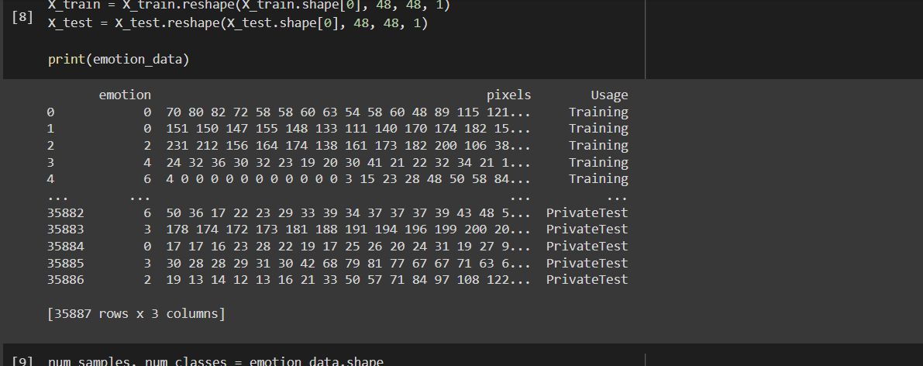
Working of caption generator model
CNN architecture
The CNN architecture is taken from efficientnet using transfer learning.
The last layer of efficientnet has been removed as we don’t need to classify, instead we just need to get an image encoding to pass as an input to the encoder layer of the transformer. Thus, the efficientnet is used as a feature extractor.
Transformer Encoder block
This encoder block takes the image encoding as the input and applies attention to it before passing it to the decoder block.
Transformer Decoder block
The five captions per image are passed one by one to the decoder along with the encoder outputs. Masked attention is applied to the sequence inputs to predict the next word.

Slide 8
Why transformers?
Transformers (Attention is all you need) were introduced in the context of machine translation with the purpose to avoid recursion in order to allow parallel computation (to reduce training time) and also to reduce drops in performance due to long dependencies. The main characteristics are:
Non sequential: sentences are processed as a whole rather than word by word.
Self Attention: this is the newly introduced 'unit' used to compute similarity scores between words in a sentence.
Positional embeddings: another innovation introduced to replace recurrence. The idea is to use fixed or learned weights which encode information related to a specific position of a token in a sentence.
The first point is the main reason why transformer do not suffer from long dependency issues. The original transformers do not rely on past hidden states to capture dependencies with previous words. They instead process a sentence as a whole. That is why there is no risk to lose (or "forget") past information. Moreover, multi-head attention and positional embeddings both provide information about the relationship between different words.

Slide 9
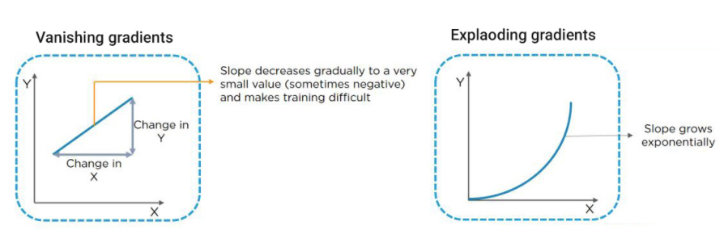
Drawbacks of RNN in Caption generation:
Vanishing Gradient
Exploding Gradient
de
----
dw
Overcoming drawbacks:
For Vanishing Gradient: ReLU activation, RMSprop, LSTMs, GRUs
For Exploding Gradient: Truncated BPTT, Clip gradients and threshold, RMS prop to adjust learning rate

Slide 10
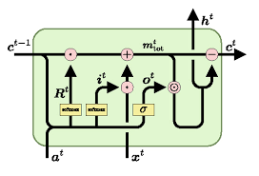
Other alternatives
LSTM
Special kind of RNN that uses tanh squashing function.
Mainly 4 internal steps:
Throwing of information from the sigmoid layer.
Input gate layer/Sigmoid layer to update values.
Tanh layer for creating a vector of new candidate values and updating it with the old state
Deciding output based on the cell state

Slide 11
references
AN IMAGE IS WORTH 16X16 WORDS: TRANSFORMERS FOR IMAGE RECOGNITION AT SCALE
BERT: Pre-training of Deep Bidirectional Transformers for Language Understanding
Image Captioning at Will: A Versatile Scheme for Effectively Injecting Sentiments into Image Descriptions
Attention Is All You Need
Learning Transferable Visual Models From Natural Language Supervision

Slide 12
Thanking you!
GitHub repo :
Collab link :

